Slide 1


Employment First:
Maintaining the Momentum
David Hoff
Institute for Community Inclusion
UMass Boston
617-287-4308; david.hoff@umb.edu
www.communityinclusion.org

Slide 2

“There are 3 essential commandments:
Respect the elders.
Embrace the new.
Encourage the impractical and improbable without bias.”
David Fricke

Slide 3

Employment First

Slide 4


Slide 5

Significant Disability
=

Slide 6

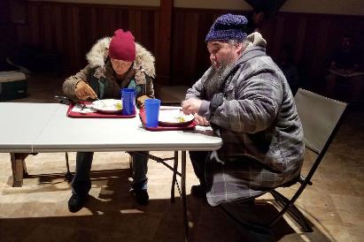
Unemployed

Slide 7
Need
Special Places
and
Special Programs
Paying Special Wages
For
Special People

Slide 8

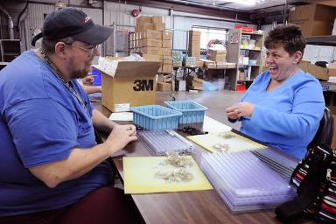

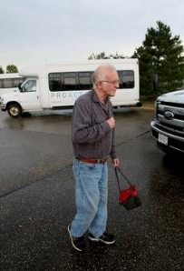

Slide 9
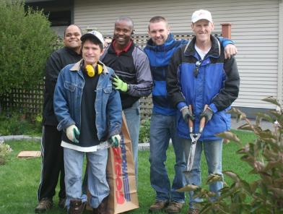
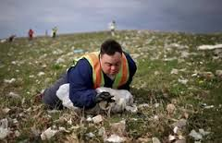

Slide 10

What’s The Issue?

Slide 11

Evolution of
Disability Models
Tragedy-Charity Model
Medical-Functional Model
Social-Rights Model
Disability is component of diverse tapestry of society
Challenges faced by people with disabilities arise primarily from social and societal forces rather than individual pathology
Disability is to be treated and cured by professionals.
Impact of disability limits impact to fully participate in society.
Disability:
victim of circumstance, deserving of pity and charity
  Elizabethan Poor Laws (1601):
  disabled or “crippled” people are helpless poor entitled to money and food from society

Slide 12
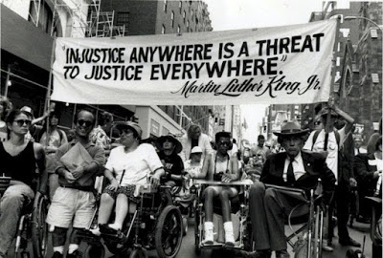


Slide 13
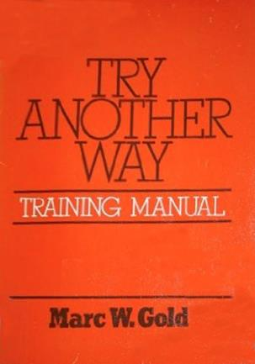
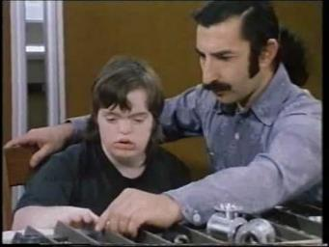

Slide 14


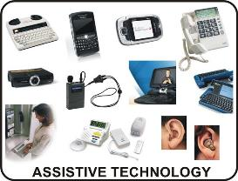
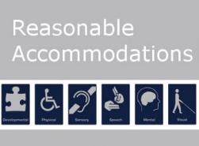
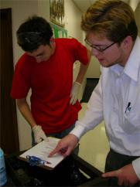

Supported Employment
Person-Centered Planning
Natural Supports

Slide 15




Evolving Policy Framework
1990
and Work Incentives Improvement Act
1999
1990

Slide 16

Disability Employment:
21st Century View
Disability:
not a barrier to employment
Right job match and supports
= job success
Full integration and inclusion

Slide 17

We have the technology

Slide 18

Focus on changing service providers

Slide 19
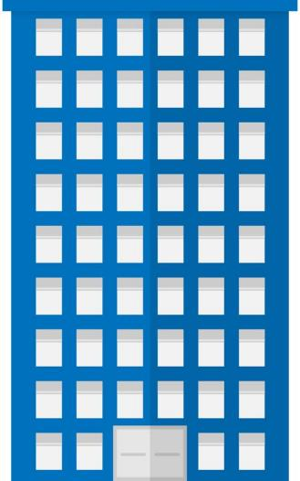

Day Program

Slide 20
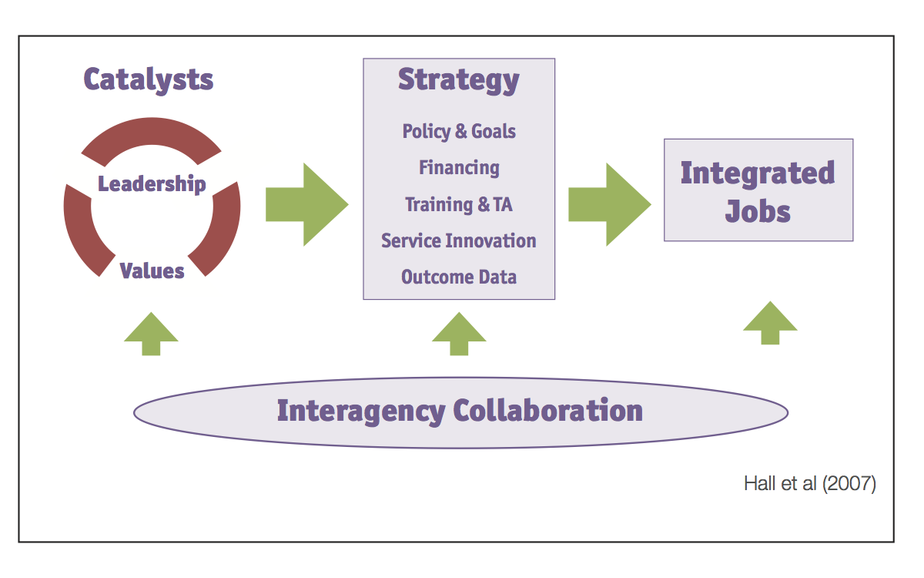
Comprehensive Systemic Approach

Slide 21


Employment in the general workforce as a core component and expectation on an individual and system level

Slide 22
Employment First: What Is It?
General theme:
Employment in the community is the first/primary service option for individuals with disabilities
APSE Statement on Employment First
Employment in the general workforce is the first and preferred outcome in the provision of publicly funded services for all working age citizens with disabilities, regardless of level of disability.

Slide 23

Employment
Policies
Practices
Resources

Slide 24
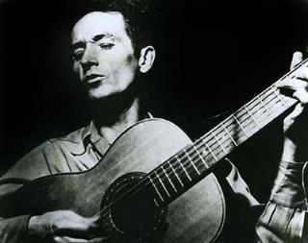
“Any darn fool can make something complicated; it takes genius to achieve simplicity.”
Woody Guthrie

Slide 25

A NATIONAL MOVEMENT
Legislation passed
in 2014
30+ States With an
Official Policy

Slide 26
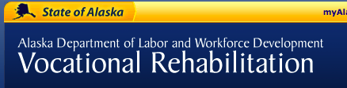


Slide 27

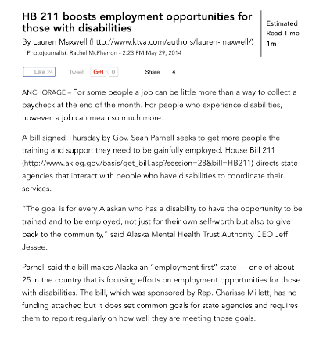

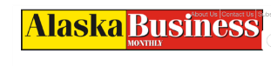
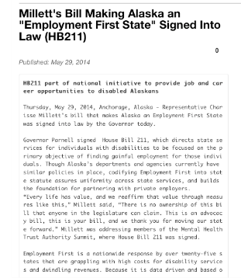
May 29, 2014
Alaska Employment First Legislation Signed

Slide 28
Employment First:
It’s not just for policymakers

Slide 29
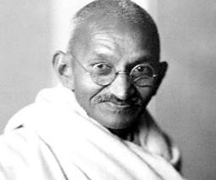
“What you do may seem insignificant, but it is most important that you do it.”
Mahatma Gandhi

Slide 30
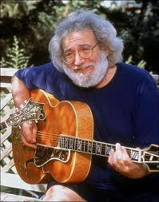
- Jerry Garcia
“Somebody has to do something, and it’s just incredibly pathetic
it has to be us.”

Slide 31
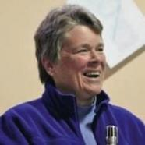
“It is nearly impossible to make your own future,
when you are not part of the economic fabric
of the culture you live in.”
- Patricia Deegan

Slide 32
Paychecks are not enough

Slide 33
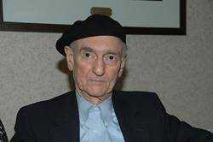

Wolf Wolfensberger
Physical integration is a precondition for the attainment of social integration
“Ultimately, integration is only meaningful if it is social integration –
if it involves social interaction and acceptance, and not merely physical presence.”

Slide 34
Employment First is a social justice and social change movement

Slide 35
The Changing Role of the Professional
FROM
Caretaker
Trainer
Authoritative figure
TO
Facilitator of inclusion
Facilitator of community supports
Support professional
Social change agent

Slide 36
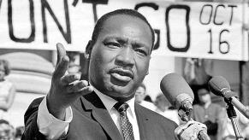

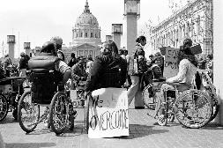

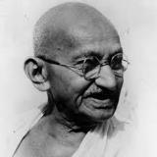
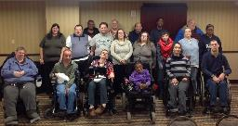
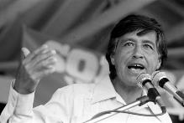
Civil Rights Worker

Slide 37
Jobs and Community
Jobs and Community

Slide 38

It’s not just about changing individual lives.

Slide 39
“ I have come to understand that the way we respond to people who are different in any way, clearly reflects our own willingness to either expand our horizons or shrink back in fear.”
Kay Drais, Parent of a Child with a Disability

Slide 40
Typical employment in the general workforce
Create a
pre-vocational “program”
Create an enclave
Start an agency business
Create a non-work “program”

Slide 41
“There are always
two choices.
Two paths to take.
One is easy.
And its only reward is
that it‘s easy.”

Slide 42
More Real Lives
Less Programs

Slide 43
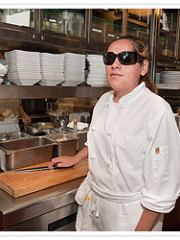
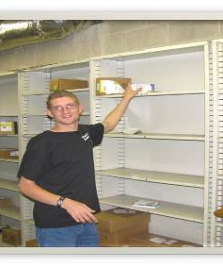
Persons with disabilities succeed on the job and in careers for the same reasons as other individuals

Slide 44
Persons with disabilities are unemployed for many of the same reasons as any other individual
Lack of education
Lack of skills
Poor personal networks
Cultural expectations

Slide 45

“My disability exists not because I use a wheelchair, but because the broader environment isn't accessible.”
Stella Young

Slide 46







Employment experience
(including employment search process) as similar as possible to those without disabilities

Slide 47
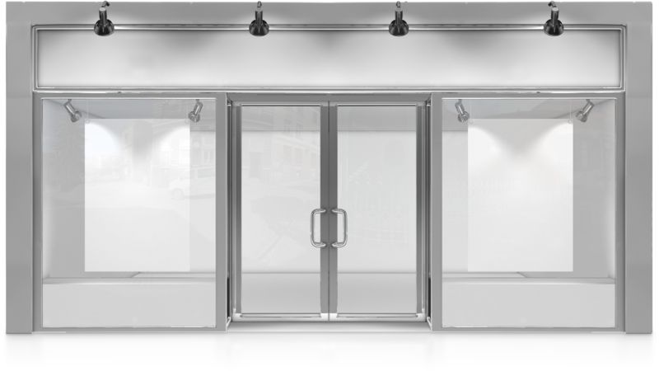
All types of jobs
FULL LABOR MARKET
No special disability jobs

Slide 48
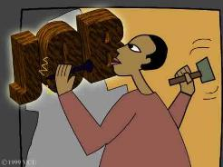
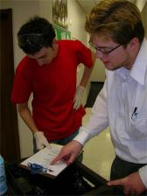
Deviate from typical employment process - only as necessary
(but sometimes it’s necessary.)

Slide 49

People with disabilities don’t go to the back of the line

Slide 50
Early employment expectations and experiences

Slide 51

Same career development strategies as other individuals

Slide 52



Consistent Messages

Slide 53
Peer
Peer

Slide 54

“When somebody say it’s not about the money, it’s about the money.”
H.L. Mencken

Slide 55
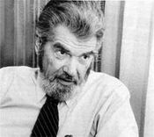
“If you can’t
measure it,
I’m not interested.”
Laurence J. Peter

Slide 56
Collecting data without using it is useless.

Slide 57

DATA
Collected and and used at all levels:
Individual, Program, School, System
Readily available
Transparent

Slide 58

Progress reports from each department due annually to the Alaska Mental Health Trust Authority

Slide 59
The
“Choice”
Issue

Slide 60


Do you want to work in the community?
NOT INFORMED CHOICE

Slide 61

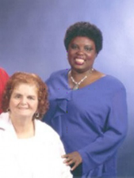
Olmstead Guidance
“Individuals’ and their families’ initial response when offered integrated options may be reluctance or hesitancy.”

Slide 62

USDOJ: Informed Choice Requirements
Affirmative steps must be taken to ensure individuals have an opportunity to make an informed choice about working in integrated settings.
Providing information about the benefits of working
in integrated settings.
Facilitating visits or other experiences in such settings: situational assessment, informational interviews, job shadowing, job tours, etc.
Peer-to-Peer Opportunities: Individuals with disabilities & families.
Identify and address any concerns or objections raised by individual or relevant decision-maker.

Slide 63

Continuous investment and raising of standards for direct service personnel

Slide 64
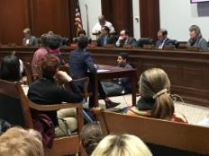


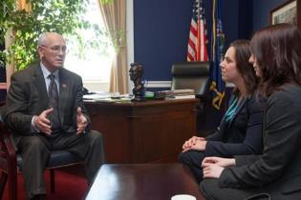

Advocate, advocate, advocate….

Slide 65
What’s your response?
Don’t want to work
Only want to work a few hours
Can’t work because of benefits
Better off in a day program
Happy in sheltered work
Not work ready
I don’t want my family member to work

Slide 66
What’s your response?
Not appropriate for employment
Service provider: let’s start a business
Let’s create an enclave
No jobs
Business: We have no openings
Service system:
provider not finding jobs
Too disabled to work

Slide 67

“What drives me up the wall is the intentional teaching of fear of having any kind of meaningful life because ‘You will decompensate’ or
‘You are stress sensitive’.
The most stressful thing in the world is being a couch potato with nothing to do, nowhere to go, and no one to talk to.”
Ed Knight, Ph.D.

Slide 68



Future of Employment First
Opportunities

Slide 69


APPS:
The New Revolution in Job Supports

Slide 70


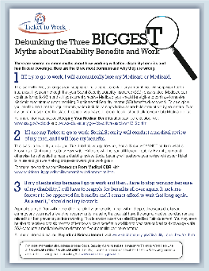



“Pro-Employment” Benefits Counseling on Demand

Slide 71
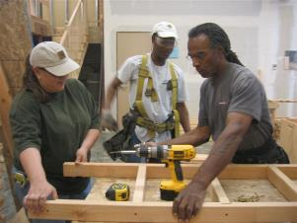




Expand Boundaries of Industry-Based Credential Training for Skill Enhancement

Slide 72
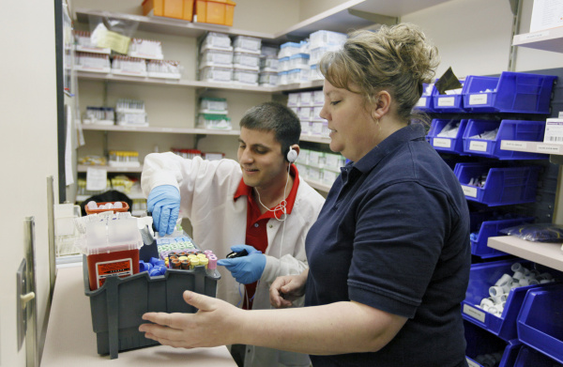
New support models:
Embedded job coaches
Compensating employers for supports

Slide 73

WIOA:
Workforce Innovation and Opportunity Act

Slide 74



Slide 75



Slide 76


Slide 77

“Be yourself.
Everyone else is already taken.”
Oscar Wilde

Slide 78

“Humanity has advanced, when it has advanced, not because it has been sober, responsible, and cautious, but because it has been playful, rebellious, and immature.”
- Tom Robbins

Slide 79
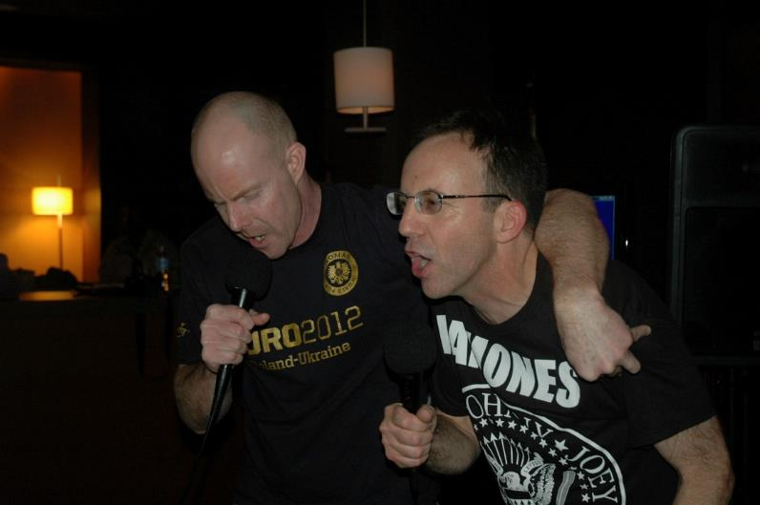

Slide 80

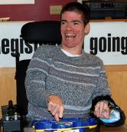


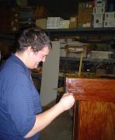


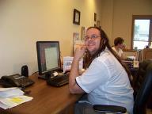
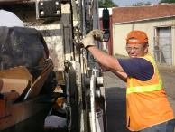

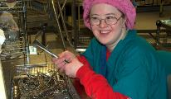
Let’s make employment for people with disabilities
NOTHING SPECIAL

Slide 81
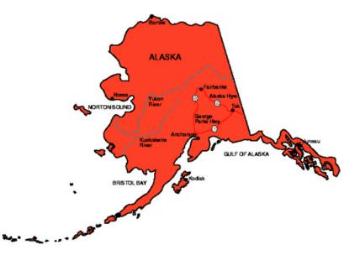
Thanks!

